Slide 1

VIDHARBHA YOUTH WELFARE SOCIETY’S
PROF. RAM MEGHE INSTITUTE OF TECHNOLOGY AND RESEARCH BADNERA - AMRAVATI
Multiple Diseases Prediction
Presented by :
Om Deshmukh(37)
Suraj Kiswe(54)
Shubham Nawale(59)
Kunal Patil(61)
Guided by :
Prof. S. A .Chorey

Slide 2
CONTENT
INTRODUCTION
PROBLEM DEFINATION
BLOCK DIAGRAM
ALGORITHM
MODEL
SOFTWARE AND HARDWARE REQUIREMENTS
SCREENSHOT
BENEFITS
RESULT
CONCLUSION

Slide 3
INTRODUCTION
Multiple Disease Prediction using Machine Learning, Deep Learning and Streamlit is a comprehensive project aimed at predicting various diseases including diabetes, heart disease,breast cancer.
This project leverages machine learning algorithms such as TensorFlow with Keras, Support Vector Machine (SVM), and Logistic Regression. providing a user-friendly interface for disease prediction. The application interface comprises five disease options: heart disease, diabetes, breast cancer.

Slide 4
PROBLEM DEFINATION
Develop a machine learning-based application using TensorFlow with Keras, Support Vector Machine (SVM),
and Logistic Regression to predict multiple diseases including diabetes, heart disease,
specific disease and provide an accurate prediction of whether an individual is affected by the disease based on the trained models..

Slide 5
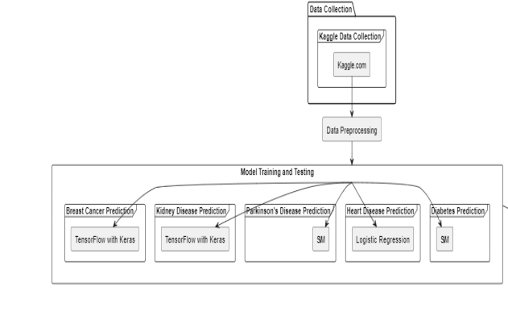
BLOCK DIAGRAM

Slide 6
Algorithm
Multiple Disease Prediction using Machine Learning, Deep Learning and django The existing system is a
Project that focuses on predicting diabetes, heart disease, using various machine
Learning algorithms. The algorithms employed in this project include Naive Bayes classifier, Decision Trees
Classifier, Random Forest classifier, Support Vector Machine (SVM), and Logistic Regression.

Slide 7
HARDWARE & SOFTWARE REQUIREMENT
Hardware Requirement –
Intel core i3 +
GPU like Nvidia GeForce
4 GB + RAM
Software Requirement –
Python 3.x
Sklearn
Matplotlib
Pandas
NumPy
PyCharm

Slide 8
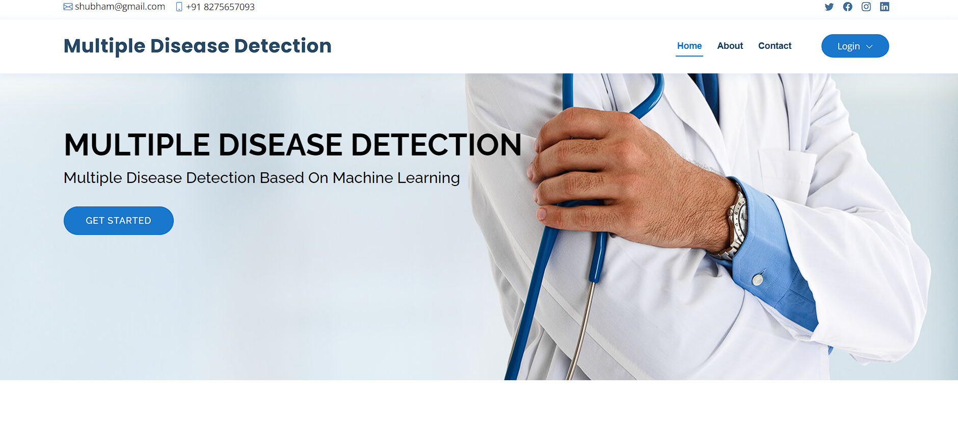
Screenshot
Home page

Slide 9
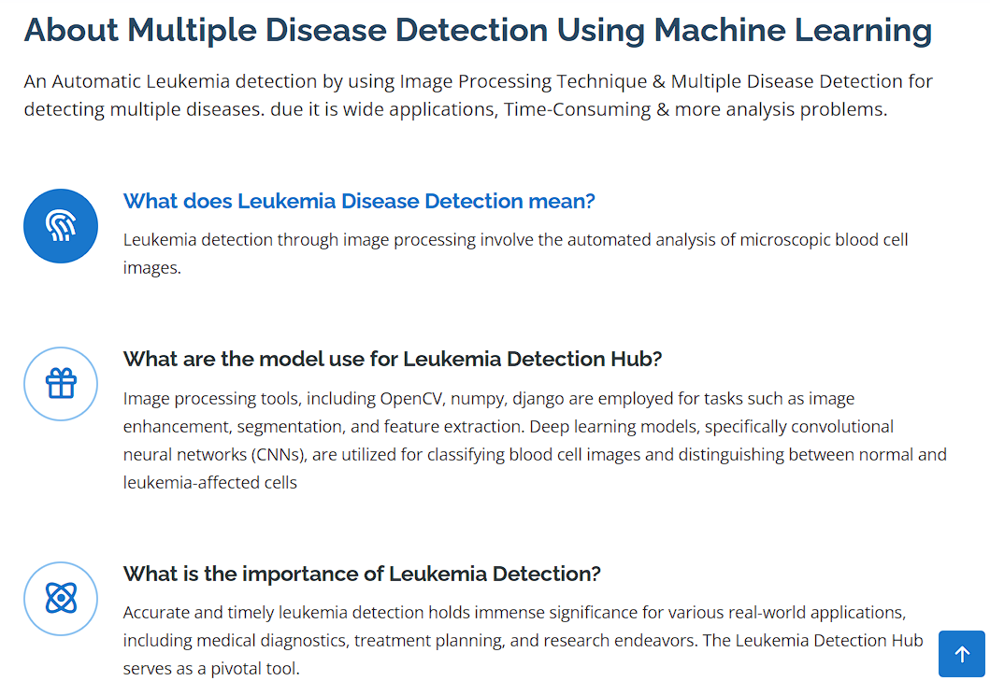
About page

Slide 10
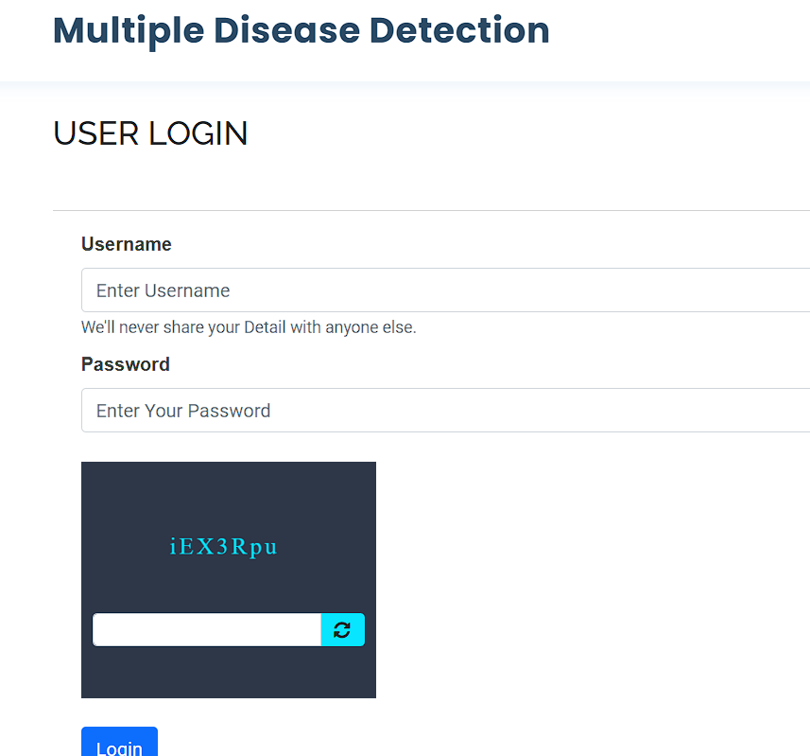
Login page

Slide 11
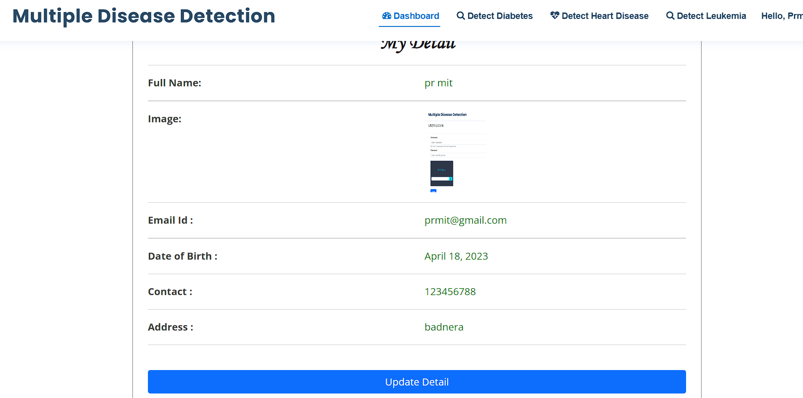
Dashboard page

Slide 12

Administrator page

Slide 13
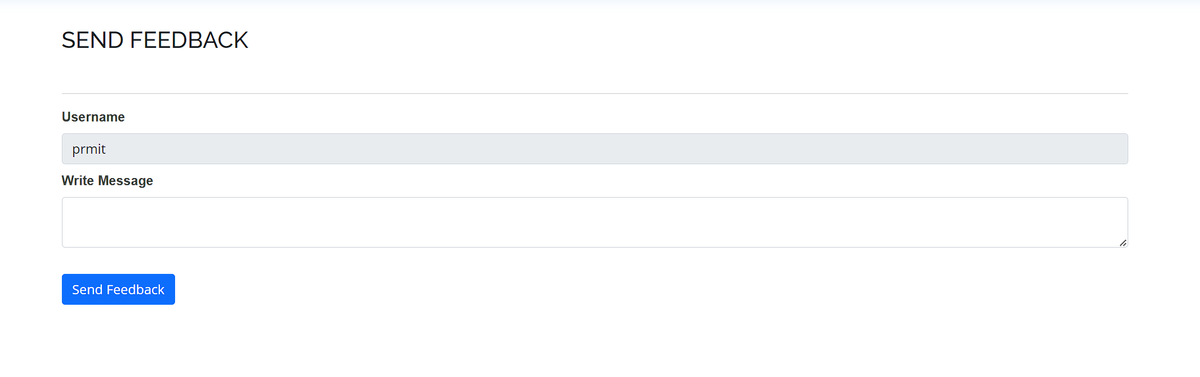
Report page

Slide 14
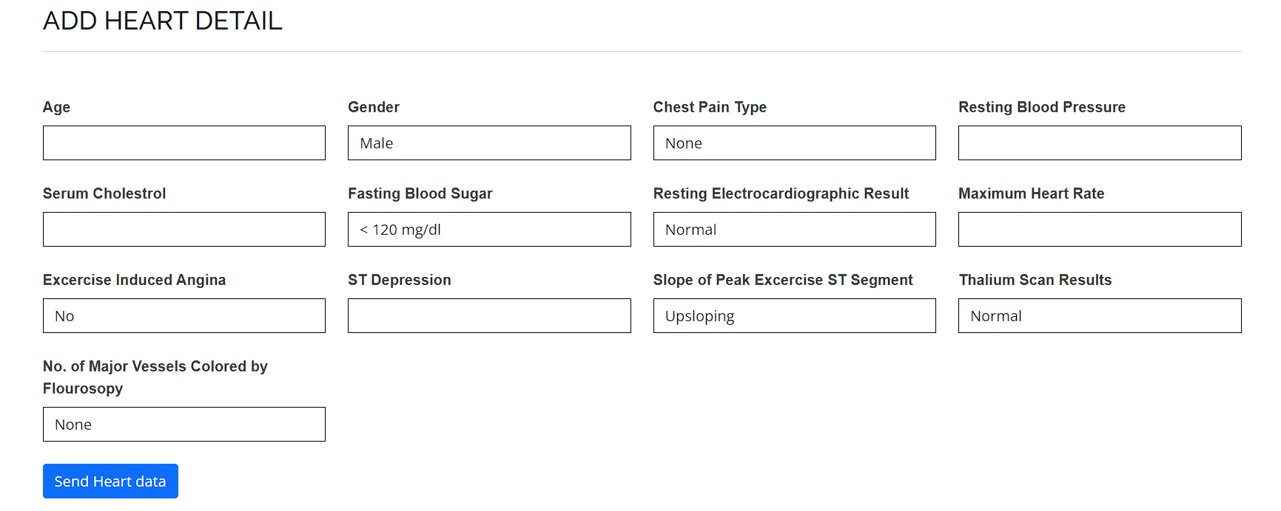
Predictions page

Slide 15
BENEFITS
Early Detection: These models can identify individuals at risk of developing heart disease before symptoms appear, allowing for early intervention and prevention.
Personalized Medicine: By analyzing individual risk factors, these models can help tailor treatment and lifestyle recommendations to each person, improving outcomes.
Resource Optimization: Healthcare resources can be allocated more efficiently by focusing on high-risk individuals, potentially reducing healthcare costs.
Improved Patient Outcomes: Early detection and personalized treatment can lead to better patient outcomes, including reduced morbidity and mortality rates.

Slide 16
RESULT
These models can often accurately identify individuals at risk of developing heart disease, allowing for early intervention and prevention. They can also help healthcare providers tailor treatment and lifestyle recommendations to each individual, leading to improved patient outcomes.

Slide 17
CONCLUSION
In conclusion, machine learning for predicting multiple diseases offers significant advantages, including early detection, accurate predictions, efficient resource allocation, personalized recommendations, cost savings, and insightful data analysis. These benefits have the potential to transform healthcare and agriculture by enabling proactive and personalized approaches to disease management and prevention...

Slide 18
Reference
Sai, P. P., & Reddy, C. , “Heart disease prediction using ANN algorithm in data mining,” International Journal of Computer Science and Mobile Computing, 2022.
S. Ghane, N. Bhorade, N. Chitre, B. Poyekar, R. Mote and P. Topale, "Diabetes Prediction using Feature Extraction and Machine Learning Models," 2021 Second International Conference on Electronics and Sustainable Communication Systems (ICESC), Coimbatore, India, 2021.
Gulpreet Kaur Chadha, Aakarsh Srivastava, Abhilasha Singh, Ritu Gupta, Deepanshi Singla, “An Automated Method for Counting Red Blood Cells using Image Processing,” ScienceDirect , 2022, 769–77.
Science, C., & Faculty, G. M. , “Heart Disease Prediction Using Machine learning and Data Mining Technique,” Department of Computer Science and Engineering, Nirma University, Gujarat, India, 2023.
M. K. Hasan, M. A. Alam, D. Das, E. Hossain and M. Hasan, "Diabetes Prediction Using Ensembling of Different Machine Learning Classifiers," in IEEE Access, vol. 8,2022.
George, J., Sobha, T., Ashok, A., & Eldhose, J. , “An efficient image processing technique to count red blood cells,” International Journal of Engineering and Research, 2020.
A, A. S., & Naik, C. , “Different Data Mining Approaches for Predicting Heart Disease,” International Journal of Innovative in Science, 2021.
Beyene, C., & Kamat, P. , Survey on “Prediction and Analysis the occurrence of heart disease using data mining techniques,” International Journal of Pure and Applied Mathematics, 2021.

Slide 19
Irwan Rahadi, “Red blood cells and white blood cells detection by image processing,” Journal of Physics: Conference Series, Volume 1539, The 5th Hamzanwadi International Conference of Technology and Education, Lombok, Indonesia, 2020.
P. Sonar and K. JayaMalini, "Diabetes Prediction Using Different Machine Learning Approaches," 2020 3rd International Conference on Computing Methodologies and Communication (ICCMC), Erode, India, 2021.
Sultana, M., Haider, A., & Uddin, M. S. , “Analysis of data mining techniques for heart isease prediction,” 3rd International Conference n Electrical Engineering and Information and Communication Technology, 2022.
Soni, J., Ansari, U., & Sharma, D., “Intelligent and Effective Heart Disease Prediction System using Weighted Associative Classifiers,” Heart Disease, 3(6), 2385–2392, 2021.
Reddy Bhavana , Prajjwal Srivastava , Sangeetha N , Rashmi Reddy “ Review on Identification of Red Blood Cells by Image Processing,” IEEE International Journal of Engineering Research & Technology (IJERT), 2021.
D. Shetty, K. Rit, S. Shaikh and N. Patil, "Diabetes disease prediction using data mining," 2017 International Conference on Innovations in Information, Embedded and Communication Systems (ICIIECS), Coimbatore, India, 2023
Kirmani, M, “Cardiovascular Disease Prediction using Data Mining Techniques,” Oriental Journal of Computer Science and Technology, 2021, 10(2), 520–528.

Slide 20


